Slide 1
ICArUS Pilot Study 1: Facility Identification
Matt Caywood, Brandon Beltz, Michael Fine
April 21, 2011
Distribution restriction:
Information in this document, in whole or in part, cannot be released outside of the ICArUS Program without the prior written permission of the ICArUS Program Manager and Contracting Officer.

Slide 2
Overview
Methods
Results
Metrics used for analysis
Performance
Subject underconfidence / conservatism
Response strategies
User interface
Future work

Slide 3
Goals
The ICArUS Program will employ a GEOINT-themed Challenge Problem to compare the models’ performance with human performance. This study is designed to:
Enable the T&E Team to work through important conceptual issues related to CP design.
Assess the ability of human participants to perform nominal sensemaking tasks involving stimuli similar in format to the final Ph. 1 CP.
Can people learn to recognize patterns/select a frame in a high-dimensional feature space?
Provide performers with initial sample data (Month 3 T&E Deliverable) to help support early modeling efforts.

Slide 4
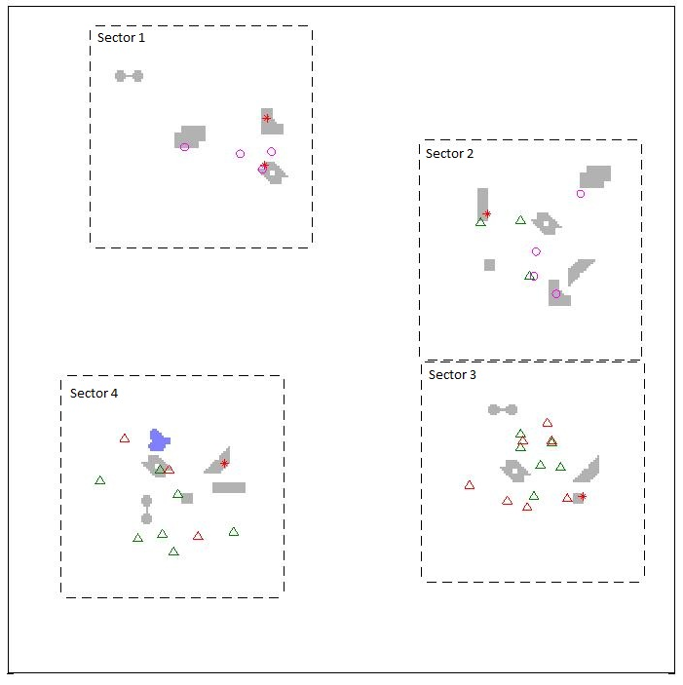
Methods: Facilities
Participants were asked to identify 4 fictitious facilities (Ketchup-, Mustard-, Salt- and Pepper-producing Factories); 2-4 facilities appeared simultaneously in the scene. A facility was comprised of data from multiple layers.
A scene with 4 facilities.

Slide 5
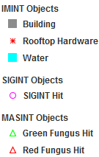
Methods: Data
Three categories of data were associated with the task (IMINT, SIGINT, and MASINT).
IMINT (Image Intelligence): the location and shape of a building, water features, and the presence or absence of rooftop hardware, e.g., a satellite dish.
SIGINT (Signals Intelligence): intelligence gathered by the interception of signals; each ‘hit’ denotes an intercepted signal at that location (e.g., a government-issued cell phone).
MASINT (Measurement and Signature Intelligence): chemical intelligence; each ‘hit’ denotes that a chemical (e.g., green or red fungus) has been detected at that location.

Slide 6
Methods: Questions
Data was presented:
simultaneously (all at once)
sequentially (one layer at a time)
or sequentially based on user choice (participants were given a choice of which data to see next).

Slide 7
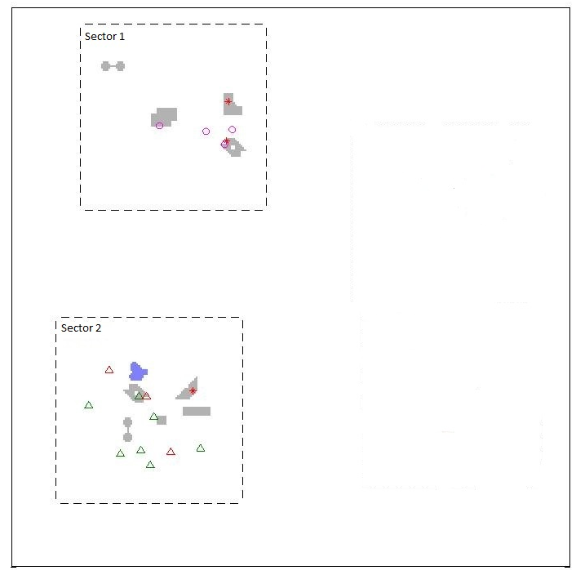
Methods: Questions
The test comprised of a series of multiple-choice questions, and all responses were in the form of likelihoods (e.g., the probability that a particular sector contained a facility). Participants were asked to either:
1. Locate a facility in the scene
2. Identify a facility in a sector
Example scene

Slide 8
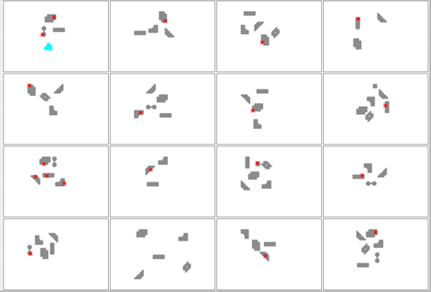
Methods: Training
Participants were trained via statistical learning (partially-annotated examples of each facility).
Annotation: 48 examples of each facility were presented, 16 at a time.
Training via example (16 instances of a Ketchup Factory shown; IMINT only).

Slide 9
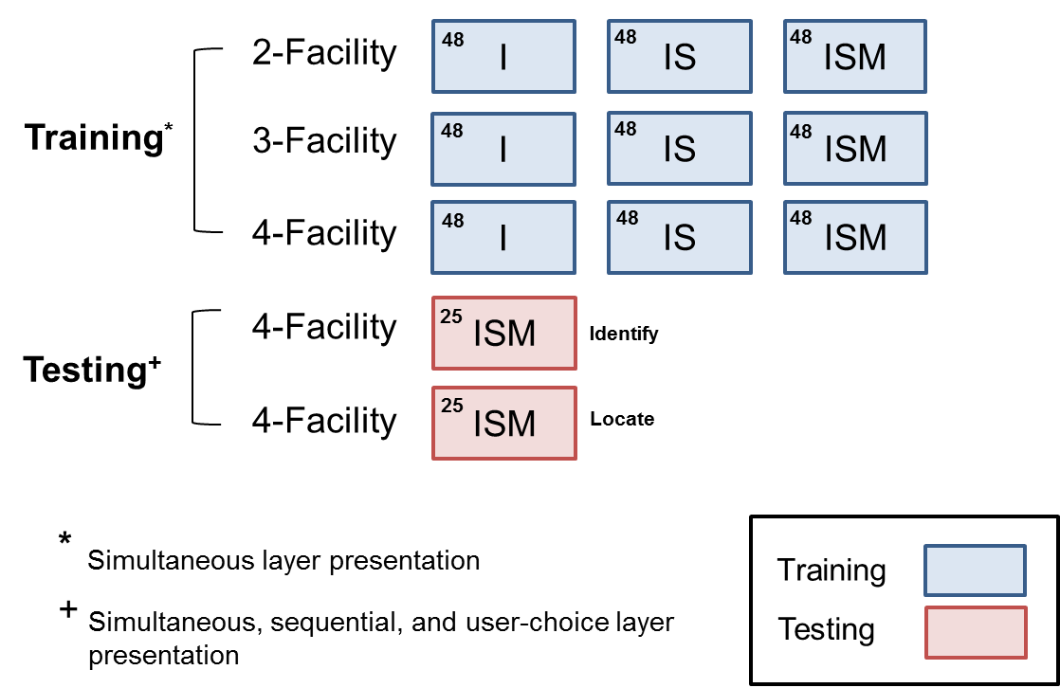
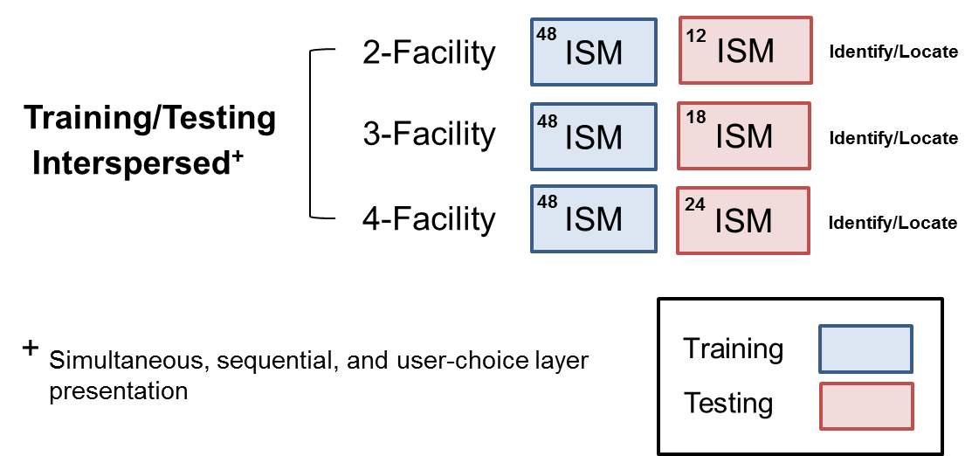
Methods: Structure
Experiment 1
Experiment 2 (Not yet run)
Exp. 1 was divided into 2 sections: training and testing. The number of training examples (training) or questions (testing) is given in the upper-left corner of each box.
In Exp. 2 (not yet run), training and testing were interspersed.

Slide 10
What was analyzed?
Data from 19 participants
50 questions (Experiment 1, Testing)
Identify and Locate questions
Subject’s final answer to all question types (Simultaneous, Sequential and User Choice)

Slide 11
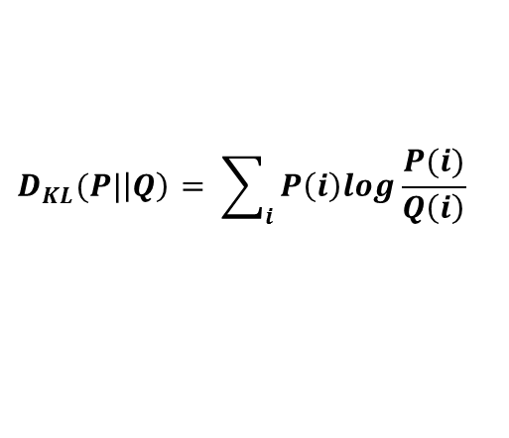
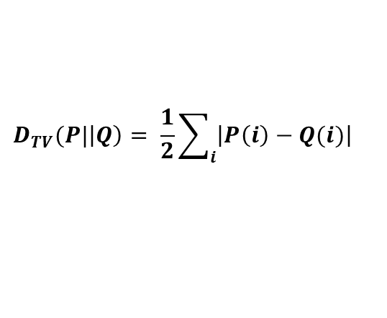
Metrics
Winner-take-all (WTA)
Did subject pick most probable facility/sector?
Very coarse measure of learning; does not address the probabilistic nature of the task.
KLD (Kullback-Leibler divergence):
Nonlinear divergence between the normative and human distribution.
In BAA; information theoretic measure.
TVD (total variation distance):
Absolute value distance between the normative and human distribution.
Linear; potentially more robust to response biases.
$$D_{KL}(P|\left|Q\right)= \sum_{i}{P\left(i\right)log\frac{P(i)}{Q\left(i\right)}}$$
$$D_{TV}(P|\left|Q\right)= \frac{1}{2}\sum_{i}{\left|P\left(i\right)−Q(i)\right|}$$
Note: these metrics were considered to elucidate how and what participants learned in the Pilot Study. They will not necessarily be used in the final, Phase I evaluation.

Slide 12
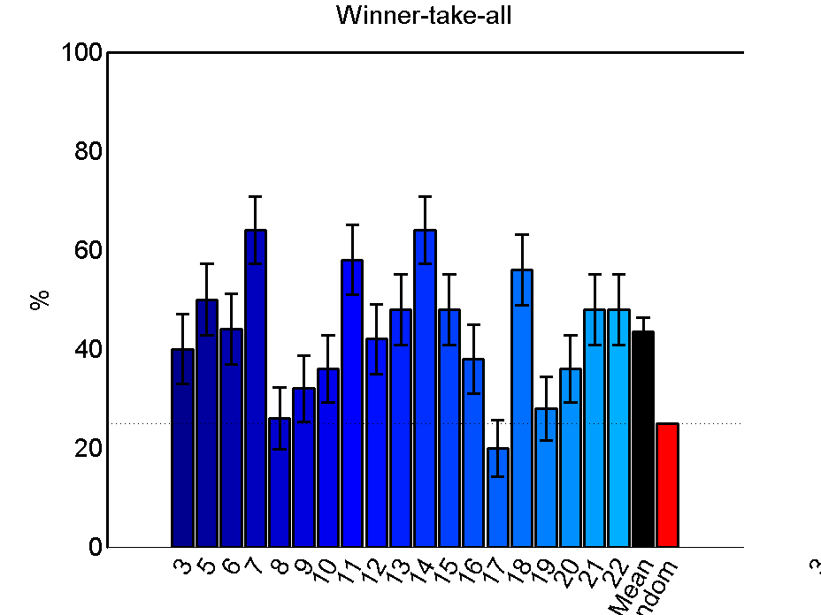
Subjects learned to categorize facilities
p < 0.00001
Subjects identified the correct facility at above-random rates (p < 0.00001).
>90% were above chance.
3/19 got nearly 60% of the facilities correct (25% random)
Mean
error bars SEM
Subject
Random

Slide 13
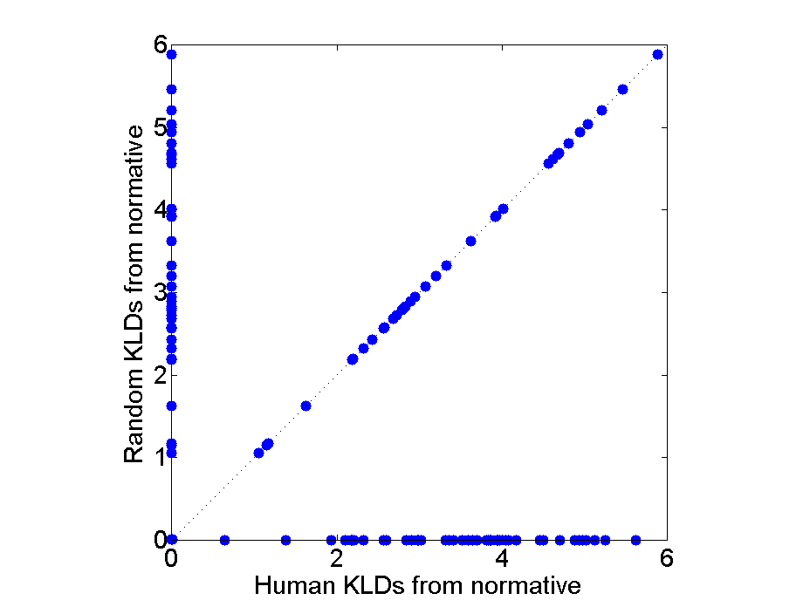
Evaluating subject performance using KLD/TVD
Normative response:
WTA proves that participants learned to categorize facilities, but responses were given as likelihoods. Here, we compare:
Humans’ divergence from normative (x-axis), to
A random model’s divergence from normative (y-axis)
Points above and to the left of the diagonal exceed random performance
A
B
C
D
Human response:
Human response:
Perfect
Random
A
B
C
D
A
B
C
D
Random KLD from normative
Human response:
Wrong
A
B
C
D
Human KLD from normative

Slide 14
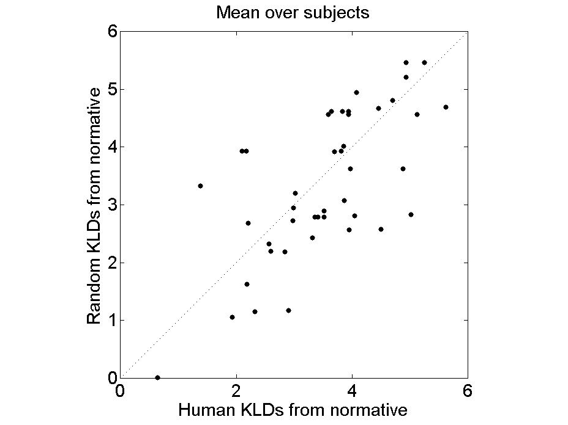
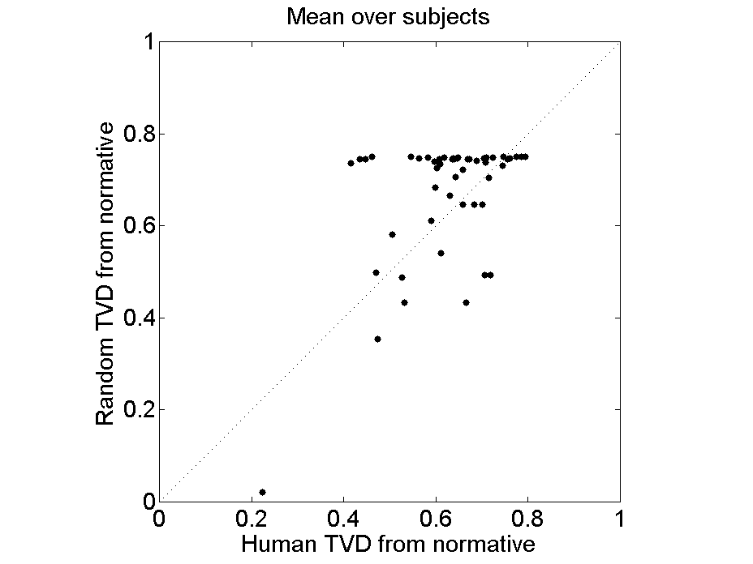
KLD/TVD, Mean performance
Performance measured via KLD was not greater than chance (p > 0.05).
Performance measured via TLD was greater than chance (p < 0.0001)

Slide 15
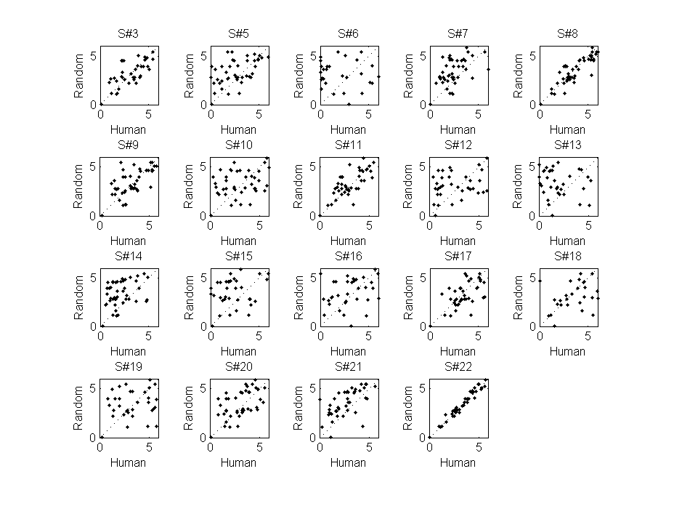
KLD, Individual performance

Slide 16
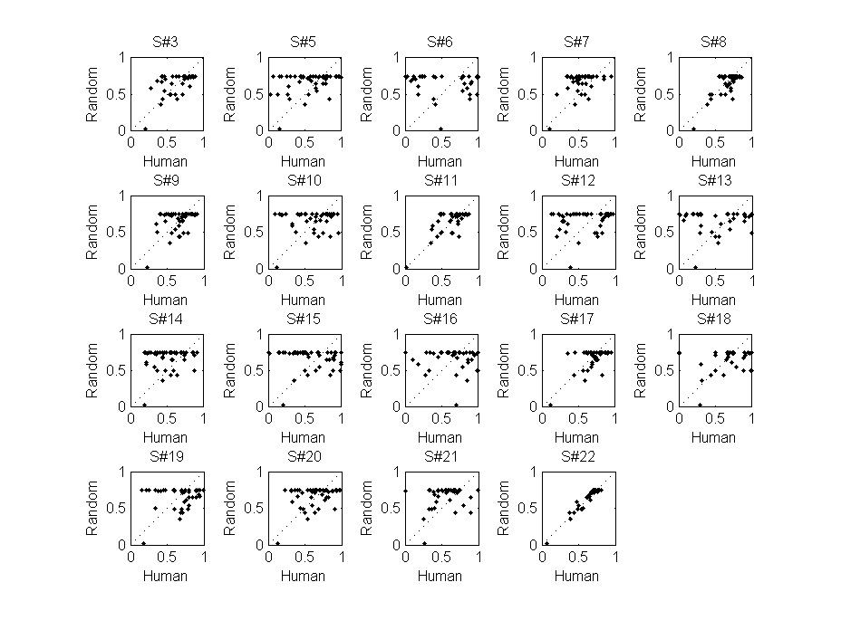
TVD, Individual performance

Slide 17
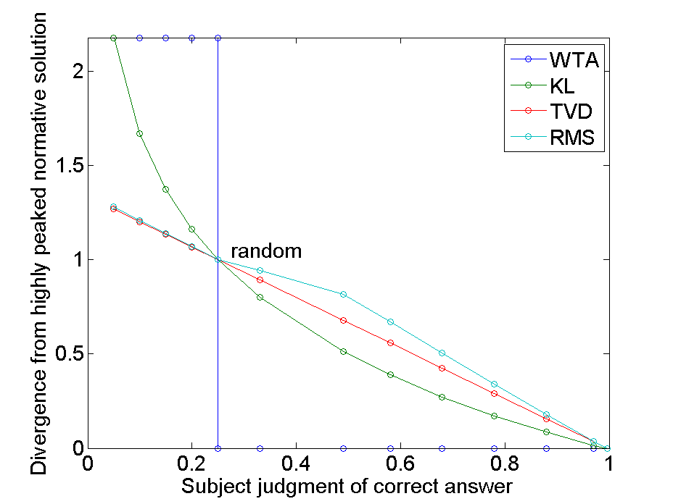
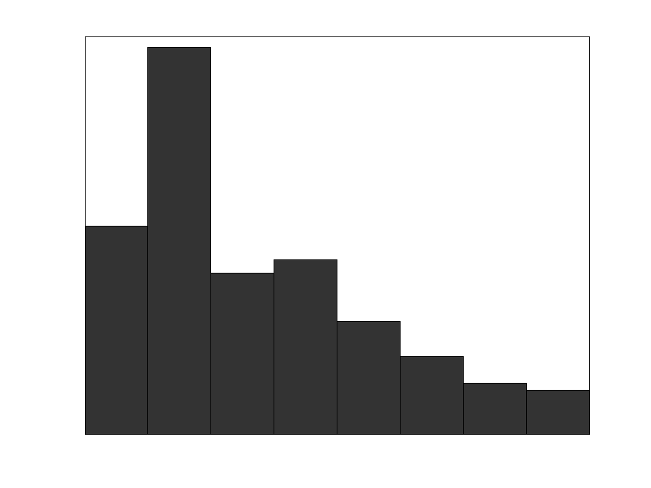
KLD did not show learning
KLD
When the normative solution is peaked (as it was here), KLD “exaggerates” mistakes due to its logarithmic nature.
TVD is a linear metric (although less commonly used).
mistaken
underconfident
correct
Observed subject judgments in pilot study

Slide 18
What types of training supported learning?
While different training types were not part of the study (yet), subject questionnaires can provide insight.
Statistical learning seemed to help subjects focus on rules
Subjects reported using about 3-5 different rules or strategies to identify facilities.
e.g. “If red and green triangles, then mustard. Circles plus no water, then ketchup. Plus others I can't remember.”
e.g. “The chemicals were the most consistent. none = ketchup, both = mustard, green = salt, red = pepper”
For rule learning, memory limits were a big issue!
All subjects reported that they forgot some of the rules they developed over the course of the experiment.
Several reported that it was very difficult to learn the facilities due to the lack of feedback.

Slide 19
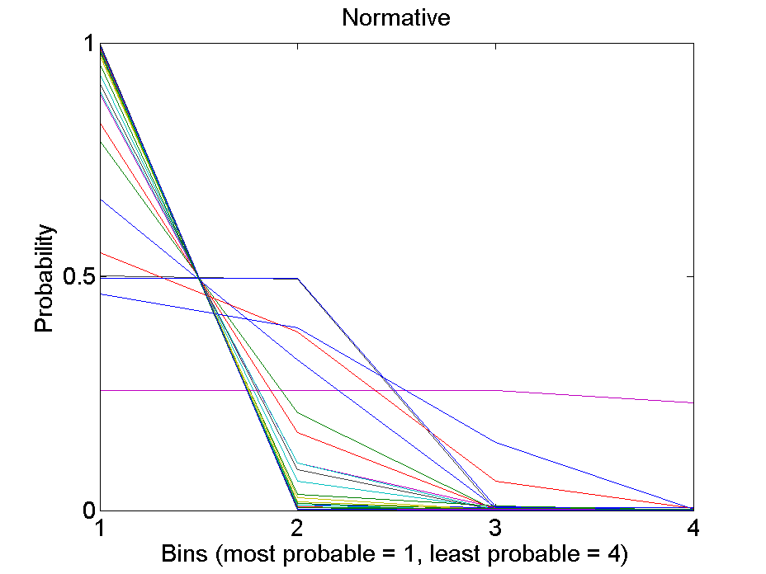
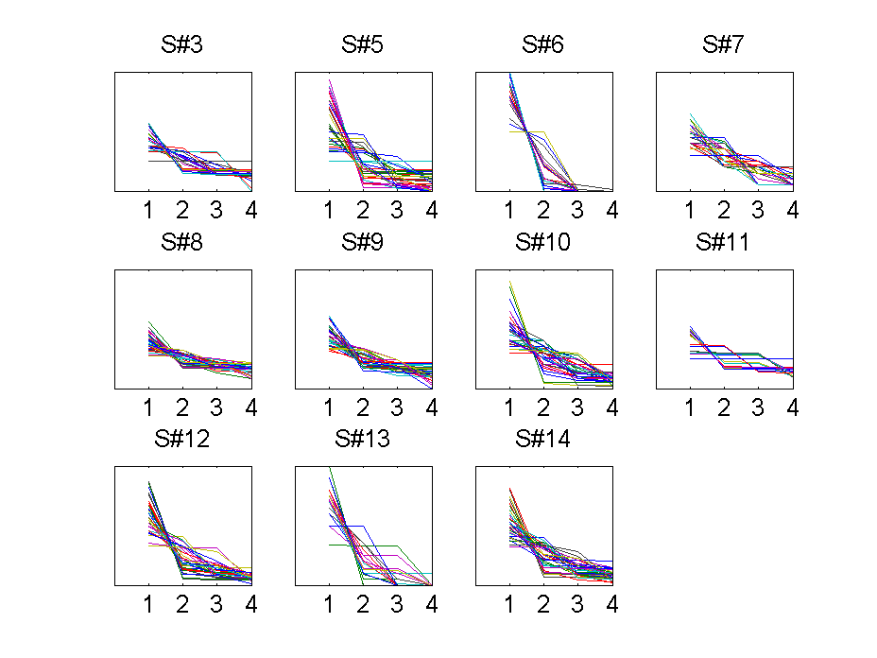
Subject judgments were much less peaked than the normative solution
3
2
4
1
1
2
3
4
1
2
3
4
Curves were rank-ordered:
This line is plotted below for each trial.
A
B
C
D
1 line = 1 trial
11/19 shown
The normative solution was very peaked after all layers were revealed (the line is steeply sloped).
Few participants gave peaked responses (with notable exceptions).

Slide 20
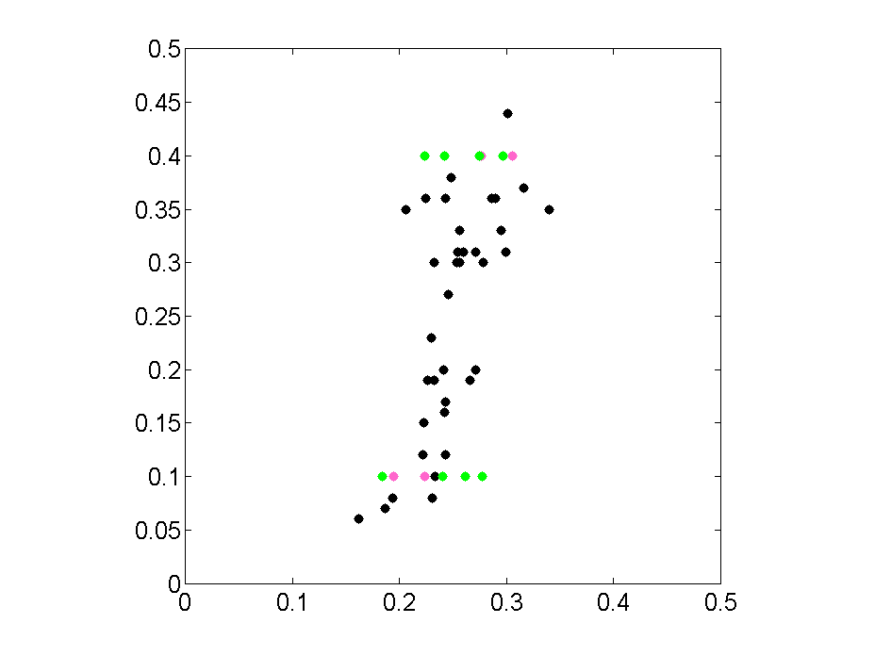
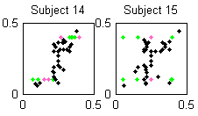
Subject underconfidence / conservatism
Subjects were able to form concepts of facilities leading to correct facility identifications
But subjects were underconfident / conservative in their responses
Some subjects did not learn feature-facility correlations effectively
(e.g. “When a sector contains SIGINT, what is the facility probability”)
But a few did, given only 48 examples!
Normative
IMINT SIGINT MASINT
Subject’s facility probability

Slide 21
User interface for eliciting probabilities may need refinement
Several subjects reported that they did not think “probabilistically” and that reporting their answers in percentages was challenging
Some subjects may have ignored the effects of normalization on final judgment
e.g. adjusting the sliders to give rank order corresponding to the ‘most probable’ facility
At least one believed that answers were ~80/20 on account of test asking about probabilities

Slide 22
Response strategies

Slide 23
Subjects had mixed opinions about overall study
Subjects were generally satisfied with clarity of directions and software usability
Difficulty was rated as fairly high
Engagement was rated as low
Question | Average Response (Scale)*
1. I think the study instructions were easy to understand. | 3.4
2. I think the study test questions were easy to understand. | 3.6
3. I think the study test questions were easy to answer. | 2.4
4. I think it was easy to use the computer software during the study. | 3.6
5. I think it was easy to input my answers using the probability sliders in the study. | 3.0
6. I felt like I was engaged or having fun during the study. | 2.2
7. I felt like I was interested in the study. | 2.9
8. I felt bored throughout the study. | 2.4
9. I felt tired throughout the study. | 3.3
n = 11 subjects
*Response Scale
Strongly Disagree (1) | Disagree (2) | Neutral (3) | Agree (4) | Strongly Agree (5)
Notes:
Some subjects did select the “strongly” options (1 or 5) on some questions so the entire scale was used.
No statistical power or confidence to these numbers. They are simply rough guidelines as to what direction subjects were leaning in their opinions.
Subjects usually did not feel engaged or like they were having fun.
Test questions were easy to understand…not so easy to answer
Computer software and sliders were slightly positive and neutral respectively
Subjects felt slightly tired, but not overly bored

Slide 24
Conclusions
Within training paradigm, subjects learned to identify the correct facility.
There was wide variation in subject performance.
Training paradigm was sufficient for some subjects, but was not optimal
Metric suitability for this CP was an issue
Probability elicitation user interface was an issue
Many other issues of CP design, subject testing, normative solutions, and data analysis were successfully addressed

Slide 25
Future analyses
Apply model from iSPiED (“How humans forget”) to fit subject data and correlate probability learning with performance
Question difficulty analysis
Are category-typical scenes easier for subjects to classify?
How do subjects perform when questions have one dominant (peaked) answer vs. multiple valid answers
Question type analysis
Did answers in sequential questions approach normative?
Were subject INT choices optimal?

Slide 26
Backup

Slide 27
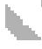
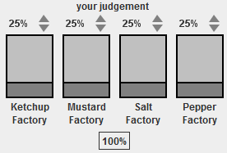
Assessment Questions 1
(1-7) When a sector contains the building pictured (e.g. ), what is the probability of each facility type?
(8) When a sector contains water, what is the probability of each facility type?
(9) When any building in a sector contains the hardware pictured, what is the probability of each facility type?
(10) When a sector contains SIGINT, what is the probability of each facility type?
(11) When a sector contains MASINT1, what is the probability of each facility type?
(12) When a sector contains MASINT2, what is the probability of each facility type?
Subject Response:

Slide 28
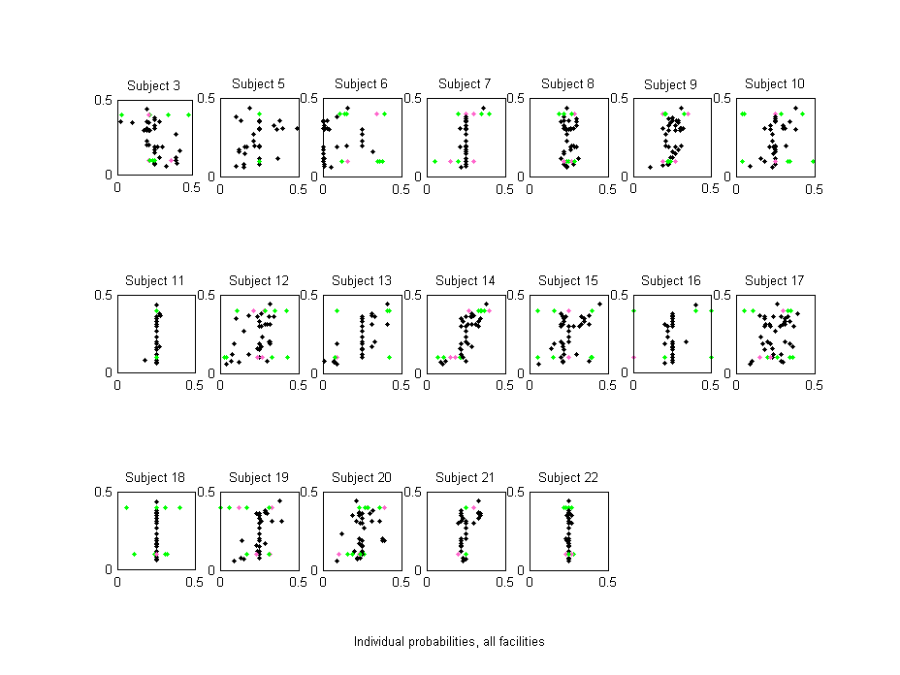
Assessment 1 Responses

Slide 29
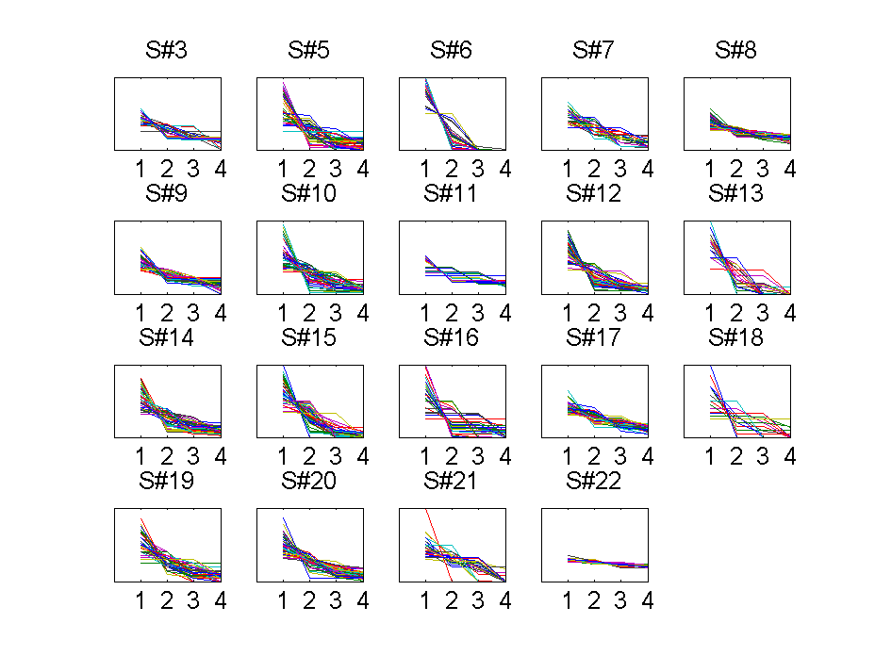
Peaked response distributions – all subjects

Slide 30
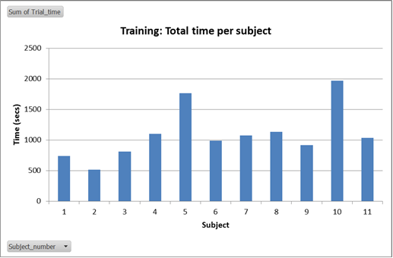
Training
Average time spent training: 18 min (range 8.5 – 33 min)
Subjects sped up (time per phase) through training

Slide 31
Experiment 1: Detailed Structure
Experiment 1, Testing (Set 19 and 20)
Defined next slide…

Slide 32
Structure Key
Question {Identify, Locate}
The type of question.
Target {A, B, C, D}
The target facility (Identify/Locate Facility A).
Presentation {Simultaneous, Sequential, Choice}
The data was presented ‘simultaneously’ (all at once), ‘sequentially’ (one layer at a time), or ‘sequentially based on user choice’ (participants were asked which layer they would like to see next).
Order
Simultaneous {ISM}
IMINT (I), SIGINT (S), and MASINT (M) were presented simultaneously.
Sequential {I-S-M, I-M-S}
Choice {I-SM}
IMINT was presented first. Users could choose to see SIGINT or MASINT.
Scene {1-16}
Scene number. Multiple questions were asked per scene.

